Slide 1
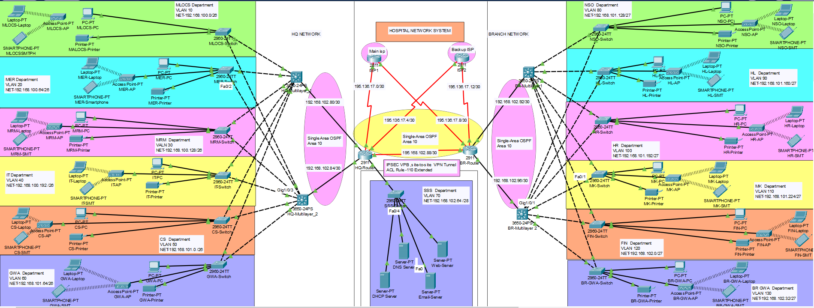
HOSPITAL NETWORK SYSTEM
DATA COMMUNICATION & COMPUTER NETWORKS
Group Members

Slide 2
Overview
Network Topology
Introduction
Network Design
Departmental Structure
IP Addressing
Security Measures
Network Security

Slide 3
Introduction
Title: "Melbourne Health Services Network Project"
Establishing an independent and secure network infrastructure across two locations.
Head Quarter Department:
Houses critical departments such as
Medical Lead Operation & Consultancy Services (MLOCS)
Medical Emergency and Reporting (MER)
Medical Records Management (MRM)
Information Technology (IT)
Customer Service (CS)
Guest Waiting Area(GWA)
Branch Department:
Designed to share the workload with the headquarters
Nurses & Surgery Operations (NSO)
Hospital Labs (HL)
Human Resource (HR)
Marketing (MK)
Finance (FIN)
BR-Guest Waiting Area(GWA)

Slide 4
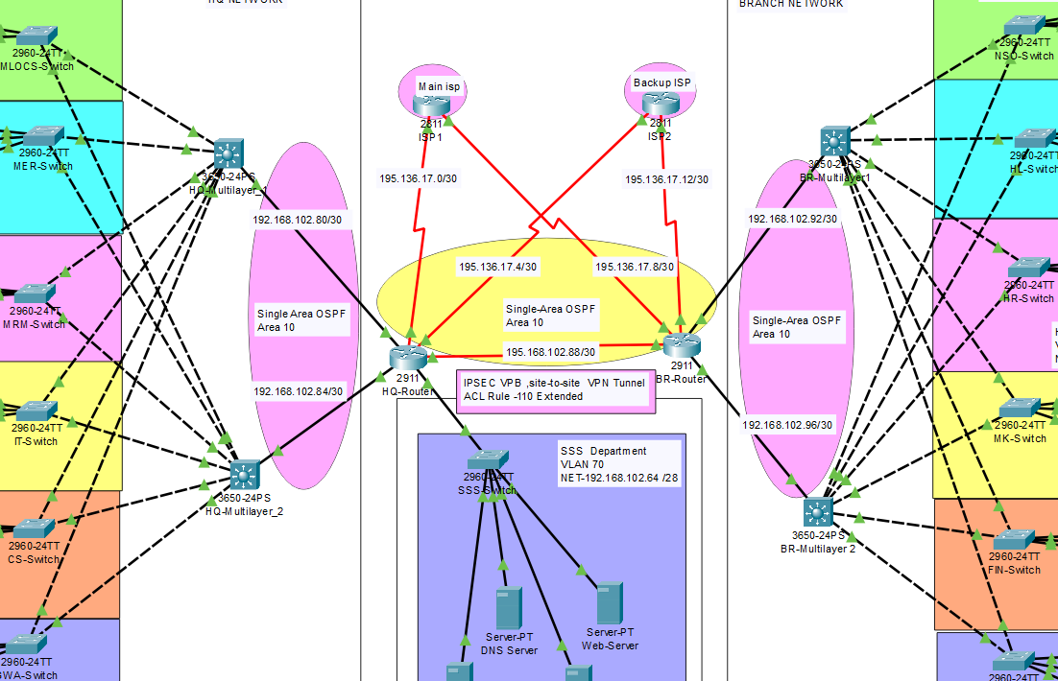
Network Design
Representation of the network layout
Hierarchy:
Core routers and switches at HQ and branch.
Departmental segmentation using VLANs.
Dedicated server-side setup for essential services.
Two Core routers connected to dual ISPs for redundancy , scalability and optimized network traffic flow
Showcasing core routers, multilayer switches, and access switches at both locations.

Slide 5
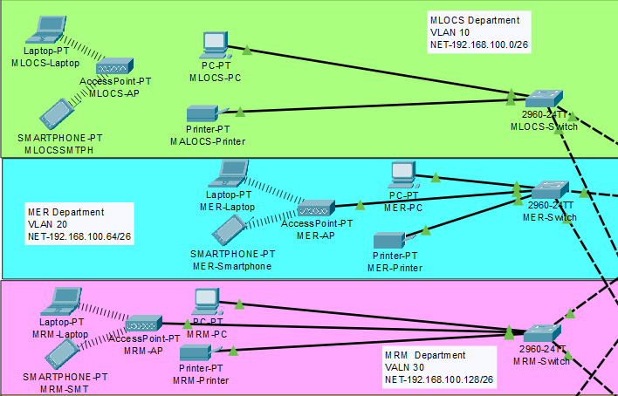
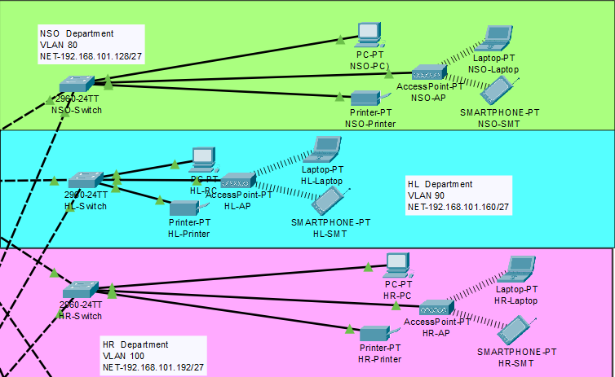
Departmental Structure
HQ Depart: MLOCS, MER, MRM, IT,CS,GWA (Approx. 60 users each)
Branch Depart: NSO, HL, HR, MK, FIN,BR-GWA (Approx. 30 users each)
Wireless Networks: Implemented across all departments..
VLANs and Subnetting: Efficient IP allocation and network isolation.

Slide 6
IP Addressing
Utilizes the base network of 192.168.100.0 and 192.168.101.0 for departmental IP allocation.
Headquarters IP Allocation:
MLOCS: Subnet 192.168.100.0/26 (Approx. 60 users)
MER: Subnet 192.168.100.64/26 (Approx. 60 users)
MRM: Subnet 192.168.100.128/26 (Approx. 60 users)
IT: Subnet 192.168.100.192/26 (Approx. 60 users)
CS: Subnet 192.168.101.0/27 (Approx. 60 users)
GWA: Subnet 192.168.101.64/27 (Approx. 60 users)
Branch IP Allocation:
NSO: Subnet 192.168.101.128/27 (Approx. 30 users)
HL: Subnet 192.168.101.160/27 (Approx. 30 users)
HR: Subnet 192.168.101.192/27 (Approx. 30 users)
MK: Subnet 192.168.101.224/27 (Approx. 30 users)
FIN: Subnet 192.168.102.0/27 (Approx. 30 users)
BR GWA: Subnet 192.168.101.32/27 (Approx. 30 users)
Network enables seamless communication among departments, supports wireless networks for user mobility, and facilitates critical services like DNS, Email, and Web hosting through dedicated servers.

Slide 7
Security Measures
Device Configurations
Routers: OSPF, default static routing.
Layer 3 switches: VLAN setup, Inter-VLAN Routing.
Dedicated DHCP server: Dynamic IP allocation.
Switch security measures: ACLs, Port-Security, SSH.
Implemented Security Measures:
Access Control Lists (ACLs) for traffic control.
Port-Security on the server-side switch to restrict unauthorized devices.
SSH for secure remote access via SSH (Secure Shell) for managing devices.
Site-to-Site IPsec VPN for encrypted communication.
NAT Overload (PAT) for efficient use of public IPs

Slide 8
Testing and Validation
Testing Procedures:
Functional & Performance Testing:
Assess network equipment functionality and performance.
Measure speed, bandwidth, and latency for optimal performance.
Network Communication:
Inter-departmental Connectivity:
Ensure smooth data transfer among departments.
Validate VLAN and Inter-VLAN Routing efficiency.
Security Validation:
ACL & Port-Security Checks:
Verify traffic control and restricted access measures.

Slide 9


